Slide 1
DEPENDABLE AND SECURE AI-ML
(AI60006)
Course Overview & Basic Introduction

Slide 2
https://portswigger.net/daily-swig/trojannet-a-simple-yet-effective-attack-on-machine-learning-models
https://portswigger.net/daily-swig/machine-learning

Slide 3
Course Structure
Introduction to dependable AI:
Resilience, robustness, safety and security
Reliable Neural Networks:
Fault Models, Assessing Fault Tolerance, Redundancy,
Reliability during the Learning Phase.
Methodology for Fault Tolerance:
Fault Locations, Fault Manifestations, Fault Coverage.
Low-cost fault-mitigation techniques:
improving the dependability through software testing
Accelerators against Soft Errors and Permanent Faults.
Measuring the Reliability of Reinforcement Learning Algorithms,
Generative adversarial networks (GAN)
Advanced Topic (if time permits):
Game-Theoretic Methods for Robustness, Security, and Resilience
Fuzzing for vulnerability detection
Integrity checks and monitoring
Provable safety and provable Defense
Formal Scenario Based Testing of Autonomous Vehicles:From Simulation to the Real World
Study Material:
https://drive.google.com/drive/folders/1at__tMA7NzkDNo3xCnCZHu-L4OQI8db2?usp=sharing

Slide 4
Course Structure
Secure AI: Privacy concerns in ML and DL,
Adversarial models:
Honest-but-curious adversary model, semi-honest entity, active adversary model.
Attacks against ML/DL:
Evasion/Adversarial attack, Poisoning, Inference, Trojans, Backdoor attacks with Case Study
Differential Privacy basics:
Properties of Differential Privacy: privacy preservation,
Sensitivity, randomization, composition, and stability;
Differential Privacy in Supervised Learning, Differential Privacy in Unsupervised Learning
Federated machine learning:
Model Training in Federated Learning and optimisation,
Privacy-Preservation in centralised FL framework:
Attack Models on FL, Privacy-preservation solutions
Homomorphic encryption and machine learning :
Basics of homomorphic encryption, Secure hyperplane decision, Naïve Bayes, and decision trees-polynomial approximations ,
Division-Free Integer Algorithms for Classification,
Homomorphic evaluation of deep neural networks,
Case study on medical data

Slide 5
Assignment 1 : Adversarial Robustness Toolbox (ART) for TrustedAI (IBM) (Python)
Assignment 2 : Pydp (Python), IBM differential privacy tool (Python), Google DP (Java/C)
Assignment 3 : Encrypted ML with homomorphic library
Grading plan (Tentative):
Class Test 1, 2: 20/100
Assignments : 20/100
MidSem & EndSem : 60/100

Slide 6
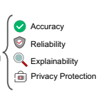
Dependable NN
Accuracy : The prediction accuracy is the basic ability of a trustworthy model. Trustworthy NNs are expected to generate accurate output, consistent with the ground truth, as much as possible;
Reliability: Trustworthy NNs should be resilient and secure. In
other words, they must be robust against different potential threats, such as inherent noise, distribution shift, and adversarial attacks;
Explainability: The model itself must allow explainable for the prediction, which can
help humans to enhance understanding, make decisions and take further actions;
Privacy protection: Trustworthy NNs are required to ensure full privacy of
the models as well as data privacy.

Slide 7
Pillars of Security
Confidentiality is satisfied if data or objects are not read by an unauthorized party.
Integrity is satisfied if data or objects are not changed (written) or generated by an unauthorized party.
Authenticity is satisfied if an author of data or an object is who it claims to be.
Availability is satisfied if data, objects, or services are available.

Slide 8
Can AI-based Components be Part of Dependable Systems?

Slide 9
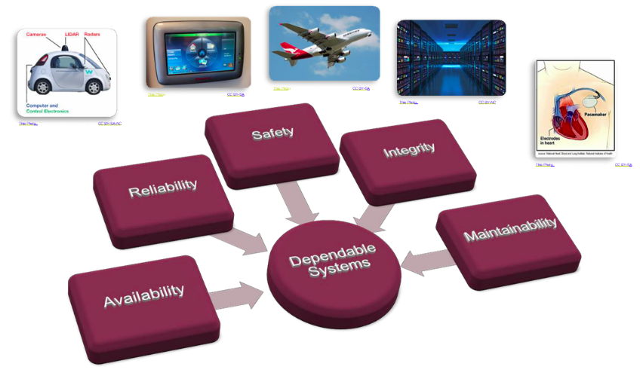
Dependable Systems
Dependable Systems can be found in many forms and application domains, but especially in transportation systems, medical systems and recently in the domain of IoT and Industry 4.0.*
*Industry 4.0 has been defined as “a name for the current trend of automation and data exchange in manufacturing technologies, including cyber-physical systems, the Internet of things, cloud computing and cognitive computing and creating the smart factory”

Slide 10
“Dependability”
Reliability how often is the system allowed to fail
Availability to which extend is the system usable, when it is needed
Maintainability how intense is the maintenance of the system
Safety how much the environment be secured against the system
Security how much the system be protected against the environment

Slide 11
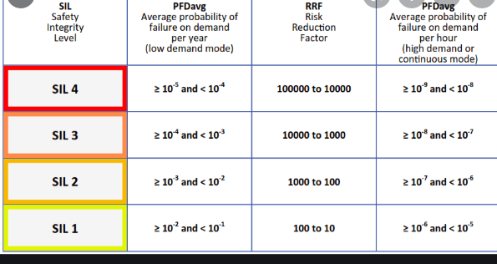
Safety Integrity Level : Standard
Safety Integrity Levels (SIL) define the criticality of the component,
Each SIL requires different development techniques as well as testing or verification methods and techniques.
The SILs are defined by the probability of failure, a risk reduction factor (can the risk of failure be reduced by a certain amount, using multiple instances, redundancy, etc), probability of failure per hour and the meantime between failure.
IEC 61508
Automatic protection systems called safety-related systems

Slide 12
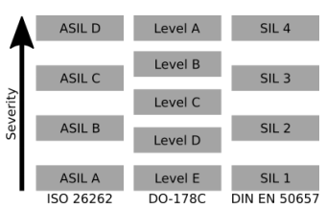
Standards: Safety integrity level (SIL)
SIL1 being the lowest and SIL4 the highest severity level:
For example in SIL4 :
high coverage of branches in the source code of a component
ensures adequate testing of the most critical components in the system.
standard procedure in avionic or automotive applications.
Civil avionic systems : regulated by DO178c
train applications DIN EN 50657
Medical devices are certified under IEC 82304, 2018 [4]
Automotive under ISO 26262 [5].
Each of these standards defines strict requirements with the goal to ensure the the functional safety of each component

Slide 13
Ensuring dependability in critical systems
Analytical Approaches: strict and rigorous review of specification, design and implementation.
Constructive Approaches: These techniques and patterns can be used as a guideline to ensure safety during the design and implementation phase of a project, for example safety cases. These scenarios can be used to directly derive the design or even parts of the implementation of the system.
Fault tolerant system with redundancy concepts can be implemented to increase the reliability and availability of the system.
In addition a fault containment strategy can be developed. If a fault occurs the consequences spread only to specific predefined boundaries, as a result, the system can stay intact.

Slide 14
Risk mitigation mechanisms
From a more technical point of view dependability properties of a system can be improved by adding risk mitigation mechanisms:
watchdog or
brownout detection.

Slide 15
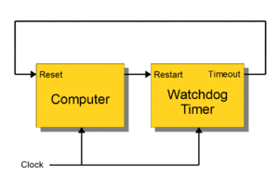
Watchdog
The hardware component of a watchdog is a counter:
set to a certain value
then counts down towards zero.
It is the responsibility of the software:
to set the count to its original value so that it never reaches zero.
If timer reaches zero:
it is assumed that the software has failed in some manner
CPU is reset.

Slide 16
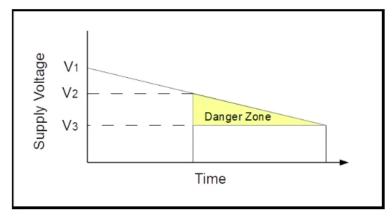
Brownout Detection
A “brown out” of a microcontroller is a partial and temporary reduction in the power supply voltage below the level required for reliable operation.
Many microcontrollers have a protection circuit which detects when the supply voltage goes below this level
puts the device into a reset state to ensure proper startup when power returns. This action is called a “Brown Out Reset” or BOR.

Slide 17
Brownout Detection
V1: is the normal power supply voltage.
V2: is the point where the microcontroller may not operate reliably.
V3: a point where operation stops entirely.
Between V2 and V3 is a “danger zone” where things can go wrong and operation is unreliable.
The device could work correctly for years while the power supply goes in and out of the danger zone and then there is a failure.
The BOR level is set above V2 and replaces the danger zone with a reset of the device.
Reset is not good but (usually) better than uncertain.

Slide 18
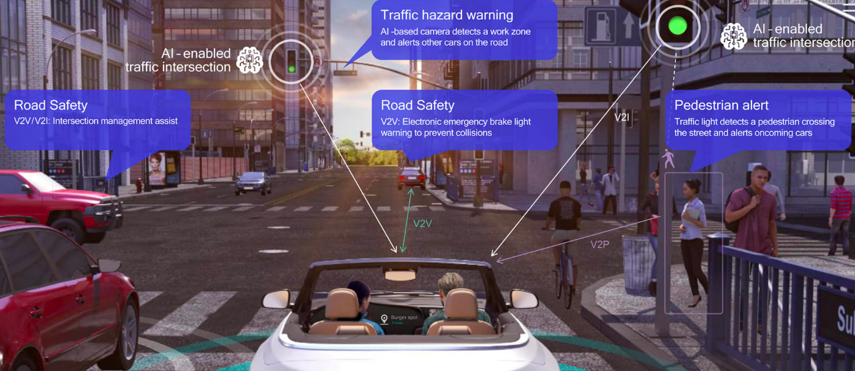
Artificial Intelligence in Critical Systems
Autonomous driving : prominent example for systems incorporating critical components derived using ML.
The capability of an AI system to react in complex scenarios in a short amount of time is unique
Enables the system to identify pedestrians or traffic signs in a fraction of classic image recognition methods used before.

Slide 19
Problems with AI-ML
ML methods are based on probabilities.
They are stochastic principles, which can only estimate the correct answer with a specific certainty.
Even though the ML algorithms might be 100% sure that the outcome is correct, the answer can still be wrong. This can e.g. happen if the quality of the training data is too low, or the data does not even contain all possible scenarios

